Slide 1
GreensGo:
Fully Autonomous
Greenhouse
Final Presentation

Slide 2
Demo & Sub-System Breakdown
Agenda
01
Introduction & Background
02
Quick look into problem and our solution
A video demo showing how the system works
Breaking the entire system down in sections
03
Value & Usage
04
Future Possibilities
What we hope to add to the market
How the data is used
What we hope to do in the future

Slide 3
Background
The future is what we make it
We as a group of final years were tasked to design and build a system that can help the United Nations #Envision2030 goals.
The United Nations proposed that by 2030 the 17 SDG must be achieved
We chose the 2nd Goal: Zero Hunger.
The problem is that many people struggle to get food because it is expensive especially is developing countries.
That is why we believe that a greenhouse can provide a family with a effective way to produce food and tackling the 2nd SDG is the process.

Slide 4
Introduction
What innovation can achieve
We believe a fully autonomous greenhouse that is:
cheap
easy
to assemble is a solution to the second SDG:
Zero Hunger.
The system will support a
modular design
that enables it to be
scalable.
Our goal is to design a
small yet effective
greenhouse that is
fully autonomous
cheap to build and easy to assemble that can provide production
365 days
of the year in a
controlled environment.

Slide 5
Demo

Slide 6
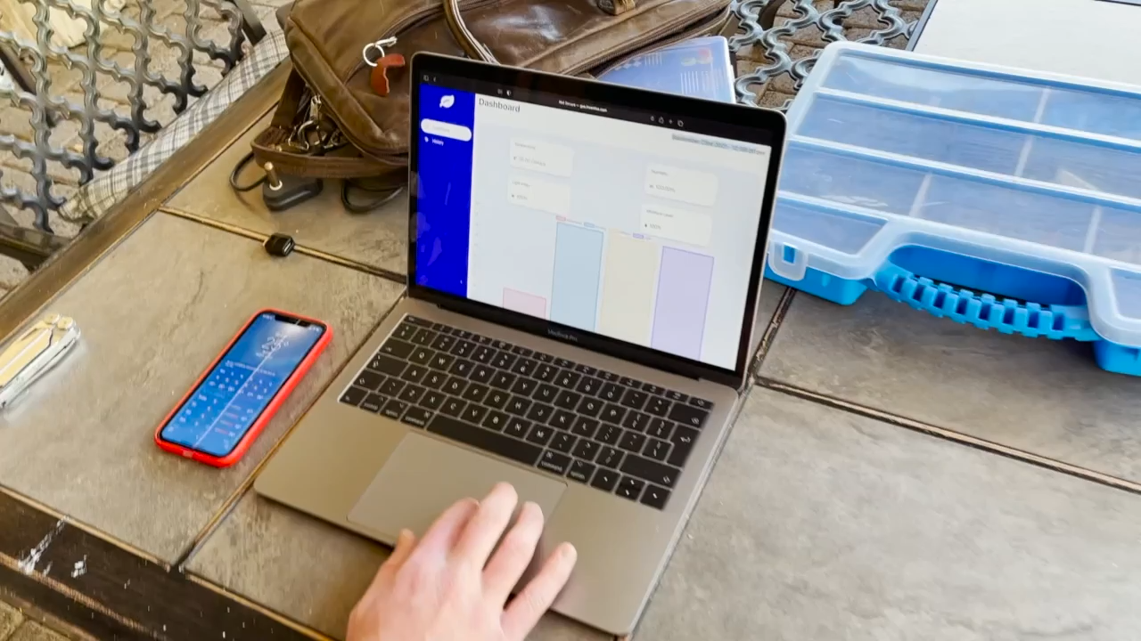

Slide 7
Sub-System Breakdown
Frontend – React
The frontend provides a visual representation of the data and gives the user a platform to interact with.
Frontend
API - Connections
API
The API is the middleman between the database and the frontend.
Backend
Backend - Server
Hardware
The backend server transmits the data from the Node in a readable format to the database. Handles hardware connections.
Hardware
Hardware - Node
The Node is responsible for getting the data from the Arduino and sending it to the backend server.
Hardware - Arduino
The Arduino is responsible for capturing data from the sensors inside the greenhouse.

Slide 8
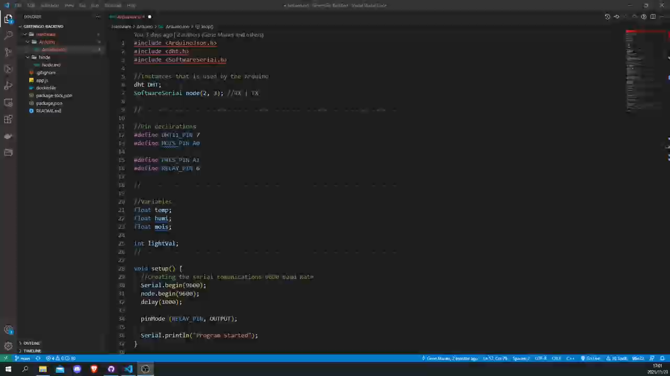
Hardware - Arduino

Slide 9
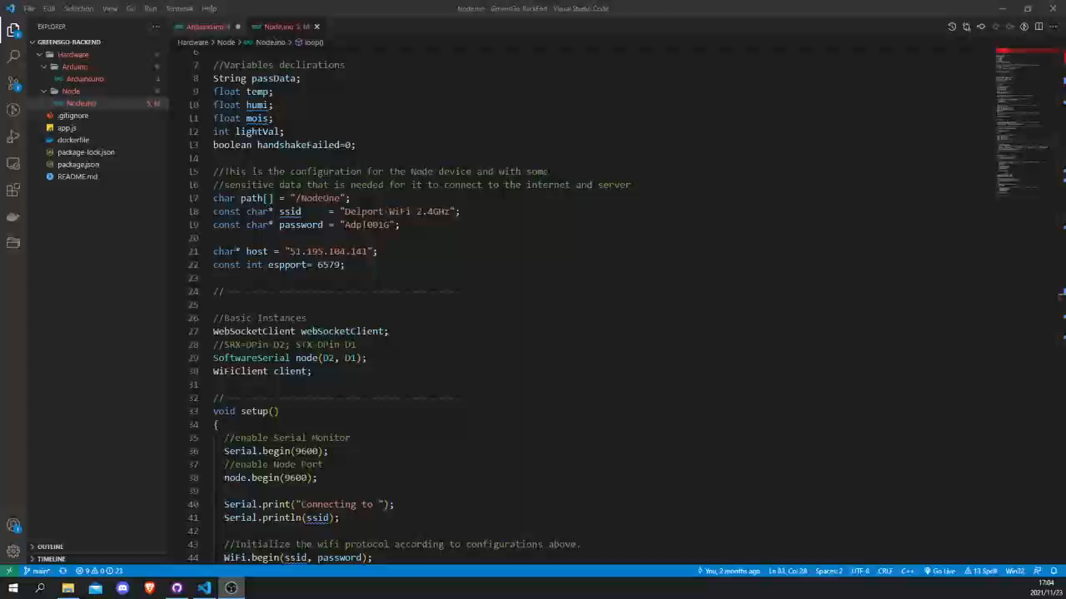
Hardware - Node

Slide 10
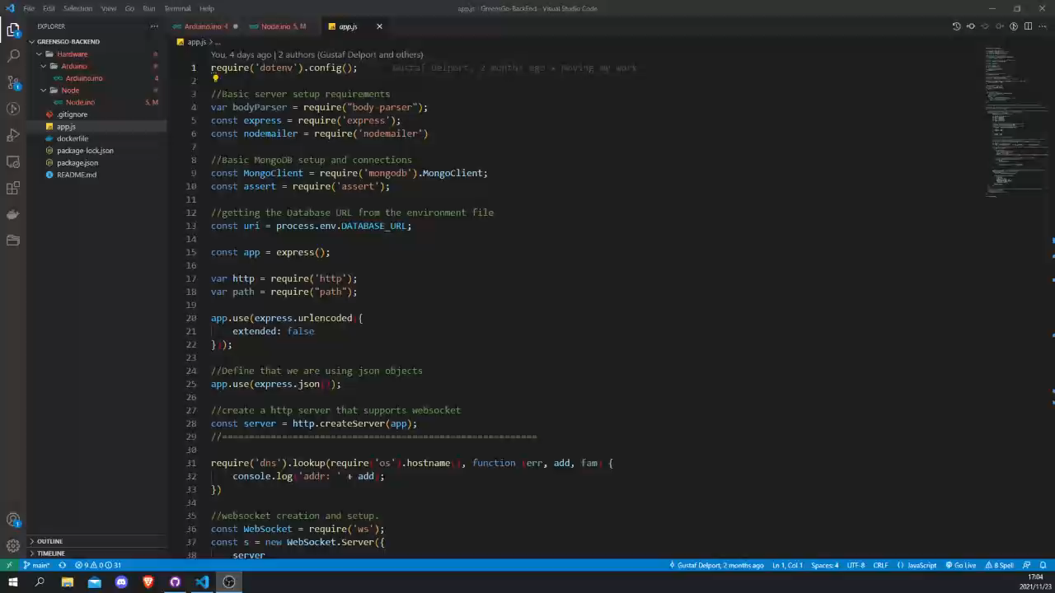
Backend - Server

Slide 11
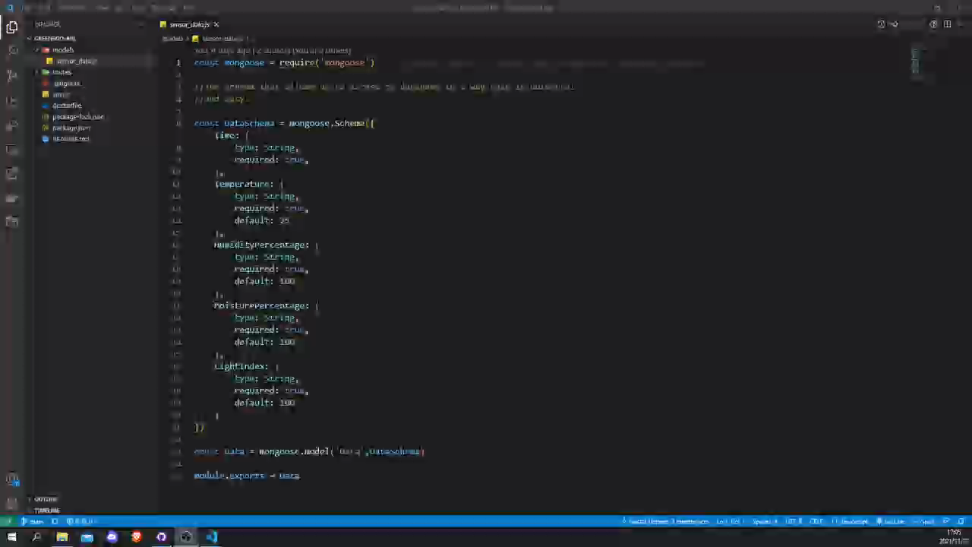
API - Connections

Slide 12
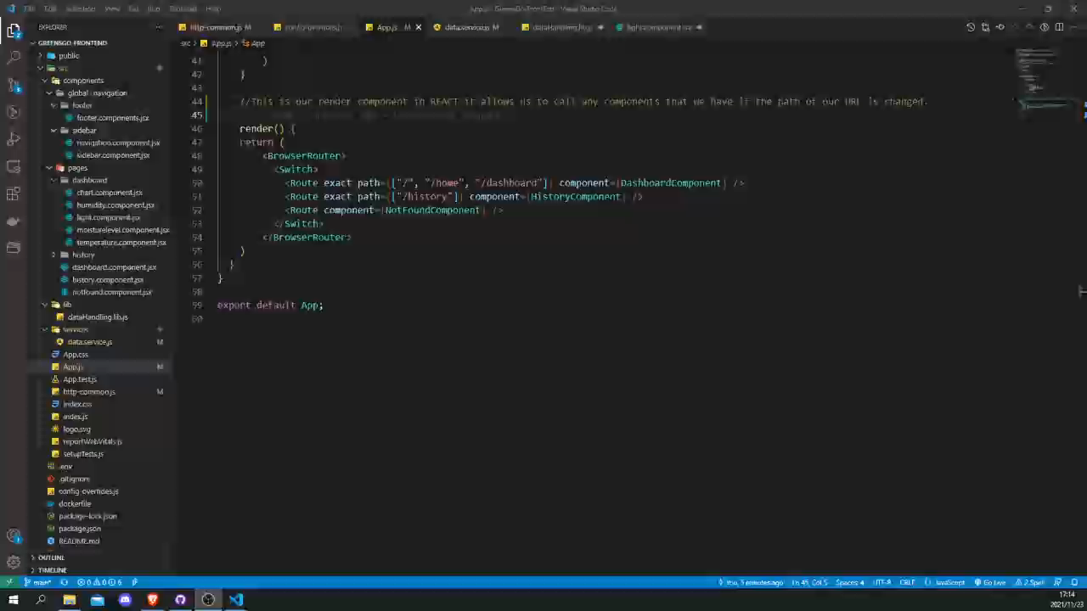
Frontend - React

Slide 13
What Makes Us Different?
Cheap
Easy
Our system is cheap to build costing less then R1500 per greenhouse.
The greenhouse is simple to build and even simpler to connect.
We shine bright.
Modular
Real-Time
If a single system is not enough you can add new ones all the time, the app is built that way.
Data is in real-time giving you active insight and giving autonomy instantly.

Slide 14
What We Can Do With Data
Diagnose
Plan
The data that is retrieved can be used by farmers to
diagnose
their current operations and identify
potential problems
The data gives
feedback
and a farmer can decide what needs to be done in order to get
better yields
Innovate
Share
AI
Can certainly be used on the data to give the household/farmer
Smart recommendations
on what needs to be done and create a
network
of information
Why hold data when you could be
prayed
for sharing data instantly and bettering
knowledge
across a community or country.

Slide 15
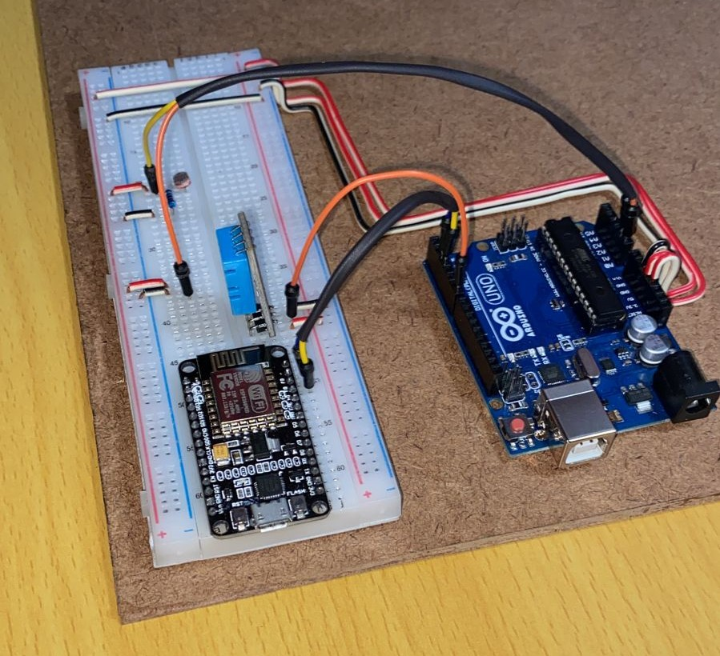
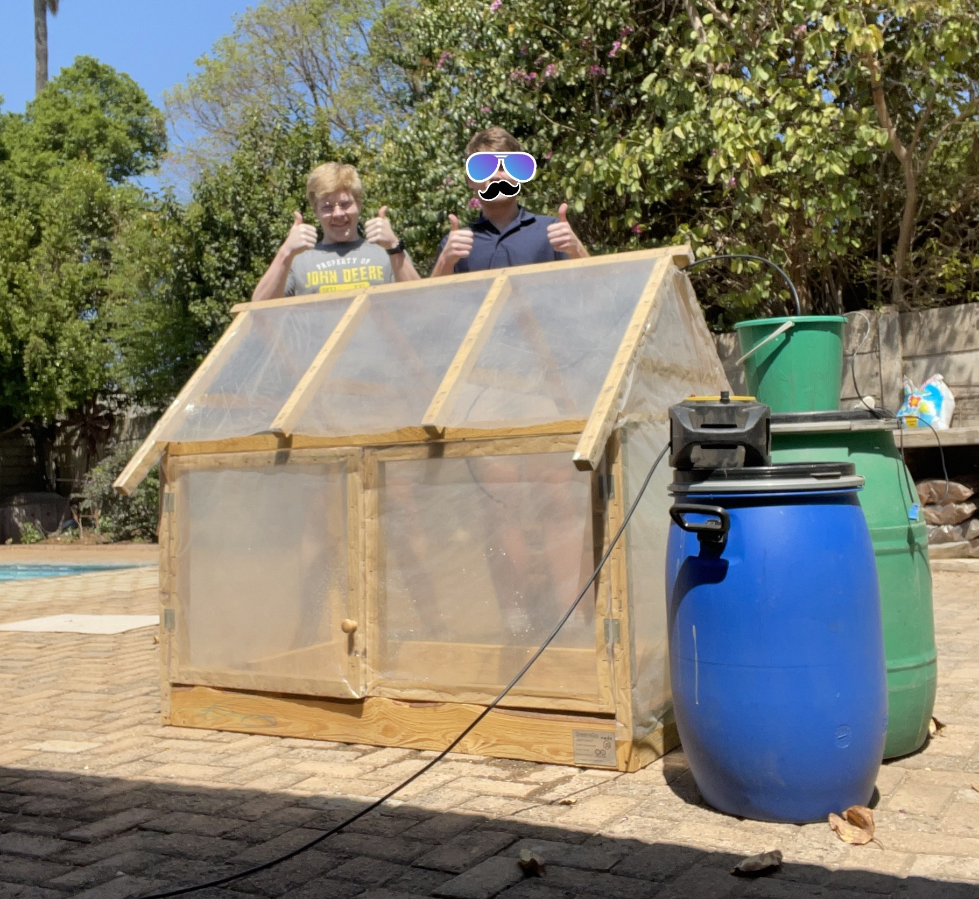

Slide 16
Future Possibilities
An improved Cooling system
Ideas
Grow
Potential Investors
Currently we are using natural air flow. A fan and a louver system can improve ventilation
Our plan and idea of GreensGo can be sold or invested into companies that are focused on environmentally friendly projects
Make smaller, more modern
Data Capture
We are going to admit our design is not the sleekest we would really like to make the device more appealing to the eye.
From the live feed we receive about the conditions and growth of items within the greenhouse we can expand further or make improvements within the project.
Innovate
Expand Knowledge

Slide 17
THANK YOU
Insert the Subtitle of Your Presentation

